Slide 1

Finance Analysis

Slide 2
Agenda Key Financial Metrics Sales & Profit Trends Regional Performance Product Segment Analysis Profitability Breakdown Dashboard Insights (Power BI) Recommendations Q&A / Conclusion
Table of Contents

Slide 3

Agenda
Analyze Key financial Metrics, Sales trends and profitability using interactive Power BI dashboards.
Gain insights to drive strategic decisions and optimize business Performance

Slide 4
The steady growth in sales reached $119 million in 2014 and Profits are reached $17 million in 2014 mostly in October and December. supported by efficient cost management and high-margin products. Units Sold exceeded 1 million, with consistent growth observed month over month. Germany, France, and Canada emerged as top-performing regions in terms of revenue and profitability. Paseo and VTT led product performance, contributing significantly to overall profit margins.
Key Financial Metrics

Slide 5




Sales and Profit trends
As per Profits and Sales are highly noticeable in month of October and December.
Sales performance varied by region, with North America and Europe showing consistent profitability.
Products which are taking less cost for manufacturing give highest sales and Profits throughout the year.

Slide 6
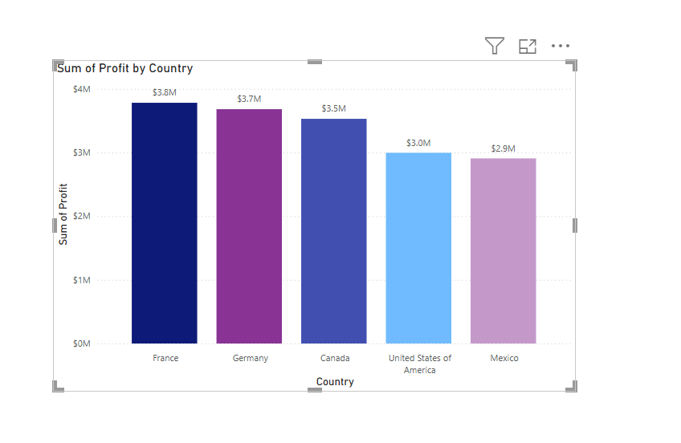
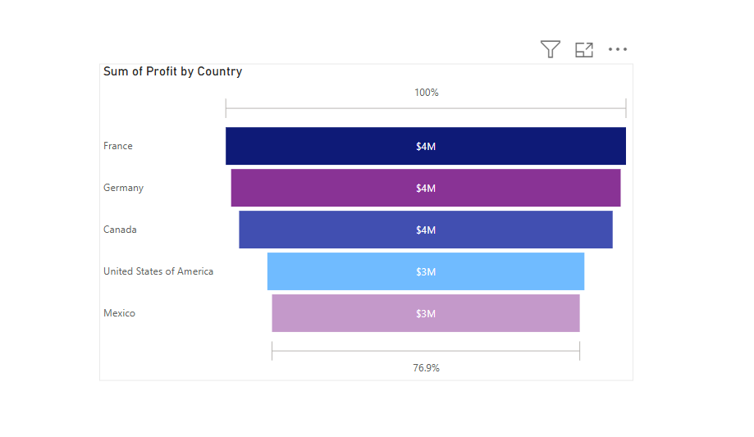


Regional
Performance
Germany led in overall sales and profit, driven by strong demand and high-margin products.
France ranked second, showing consistent growth and solid performance across all quarters.
Canada showed notable profitability, with efficient operations and low discount rates.
USA contributed the highest sales volume, though profit margins were slightly lower due to higher operational costs.
Asia-Pacific regions showed emerging potential, indicating opportunities for expansion and targeted strategies. In North America and Europe showing consistent profitability.

Slide 7
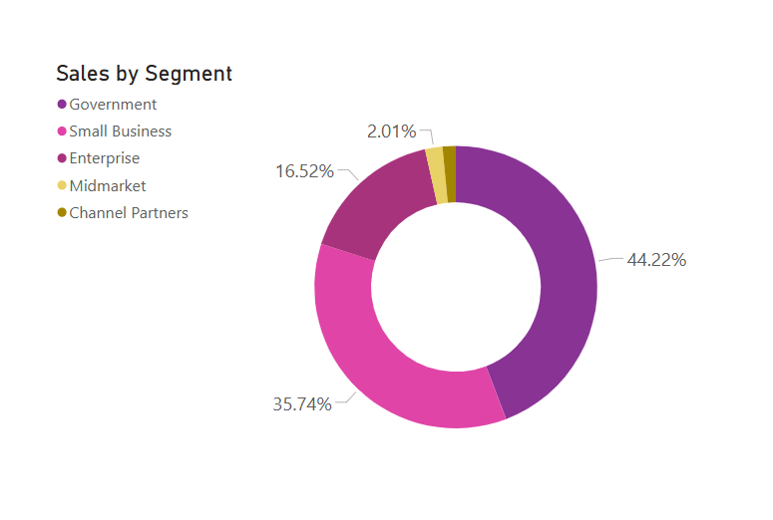
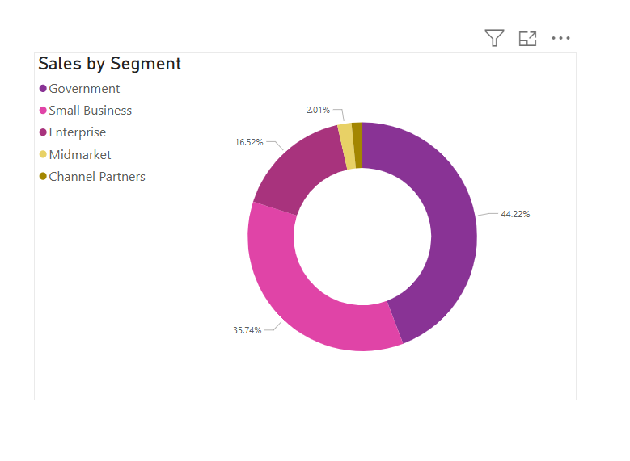
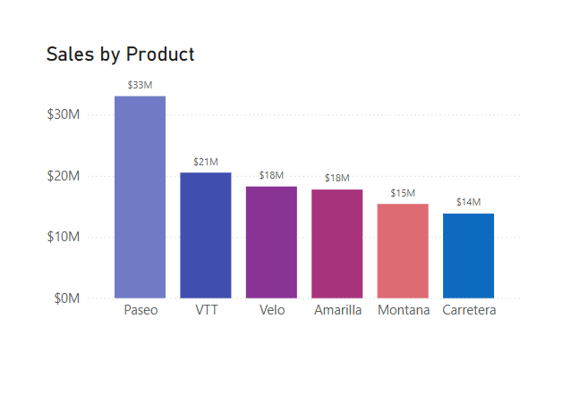
Product Segment Analysis
In Product Paseo and VTT are Top Selling Products .
Products generated a max of $33M Sales in a Year
Midmarket and Government customer segments displayed the highest profitability, suggesting focus areas for strategic growth.
Midmarket and Channel Partners showing very less Profitability.
Carretera and Montana had lower revenue impact.

Slide 8
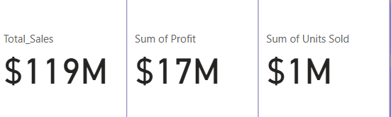

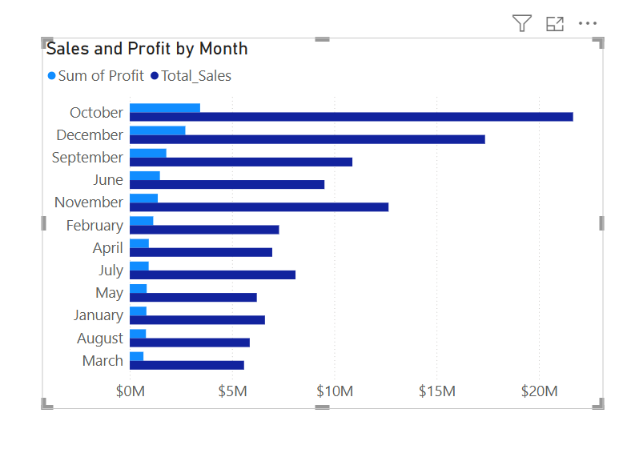
Profitability Breakdown
📈 Monthly profits peaked in October and December, driven by seasonal demand and promotional campaigns.
📉 Lowest profits were recorded in February, aligning with post-holiday slowdowns in sales.
Units of Products Sold is pretty Average

Slide 9

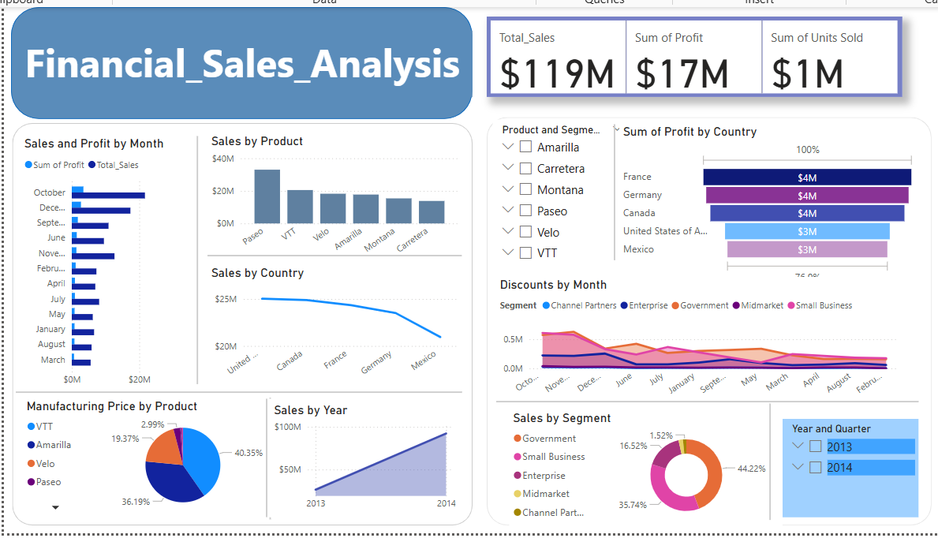
Dashboard
Insights

Slide 10

Recommendations
1. Focus on High-Performing Products
– Invest in marketing for top products like Paseo and VTT to boost overall profit.
2. Strengthen Presence in High-Profit Regions
– Prioritize sales strategies in Germany, France, and Canada.
3. Improve Cost Efficiency
– Analyze operating expenses in low-margin areas (e.g., USA) to enhance profitability.
4. Leverage Seasonal Trends
– Plan promotions and inventory around peak months like October and December.
5. Expand Midmarket Segment
– Scale midmarket offerings which show consistent growth and strong margins

Slide 11

Conclusion
The financial data reveals steady growth in sales and profitability, especially in key regions and products.
Power BI dashboards enabled clear visibility into trends, performance, and opportunities.
Strategic focus on top regions, products, and segments can accelerate growth.
Continued monitoring and optimization are key to sustained financial success.
Thank you! Open to questions and discussion.

Slide 12
Thank
You
Let’s Connect
http://www.linkedin.com/in/meesala-vandana
Email : vandanameesala2002@gmail.com.

